Slide 1



GRAND ERIE DISTRICT SCHOOL BOARD
Welcome to Secondary School

Slide 2
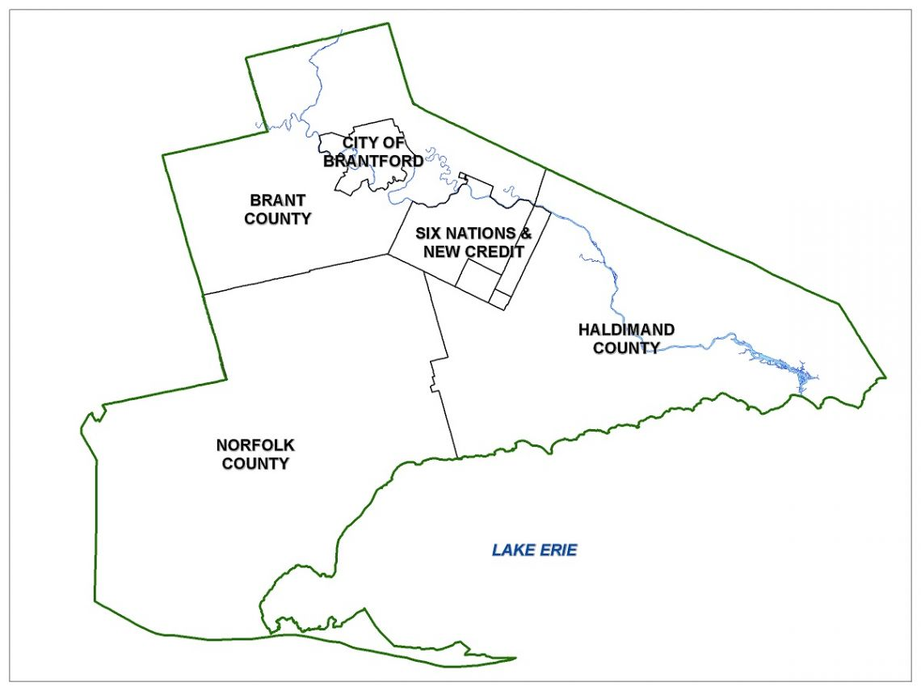
Land Acknowledgement
Notes:
The Grand Erie District School Board recognizes the Haudenosaunee and Anishinaabe people, as the traditional peoples of this territory. We acknowledge and give gratitude to the Indigenous peoples for sharing these lands in order for us to continue our work here today.

Slide 3
The Grand Erie District School Board recognizes that transition from elementary to secondary school is a time of uncertainty and opportunity. To ensure SUCCESS for Every Student, it is our goal to support and prepare students by providing programs and experiences within a caring and inclusive learning environment.
Notes:
https://www.granderie.ca/board/about/multi-year-plan

Slide 4
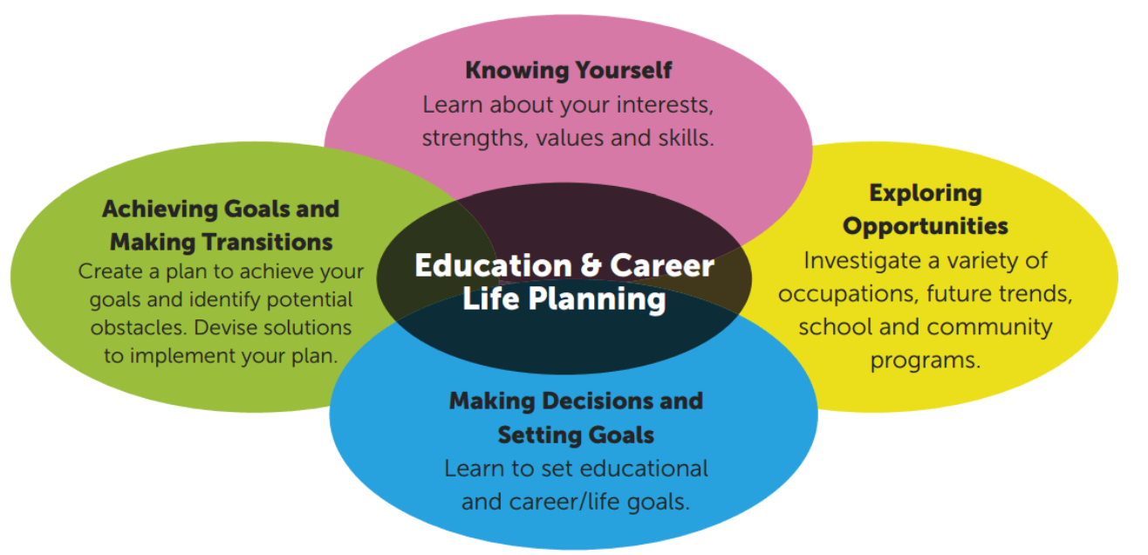
Individual Pathway Plan(IPP)
The IPP helps students develop the knowledge and skills to make informed education and career/life choices.
Notes:
Students use myBlueprint to:
create and update their IPP;
build a personal portfolio;
develop a resume; and
gather information on specific careers, colleges, apprenticeships, university programs and job searches.

Slide 5
Requirements to earn your Ontario Secondary School Diploma (OSSD)
30 secondary credits
Successful completion of the Ontario Literacy Requirement
40 hours of community involvement
Notes:
You may wish to refer to the Grand Erie’s community involvement information page: https://www.granderie.ca/board/secondary/graduate/community-involvement-40-hours

Slide 6
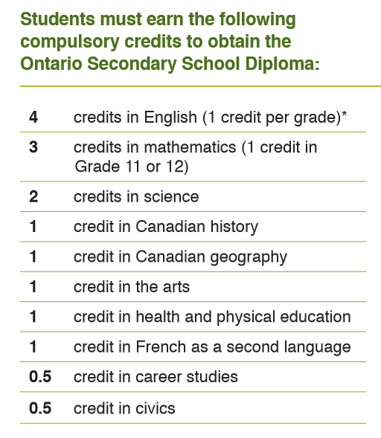
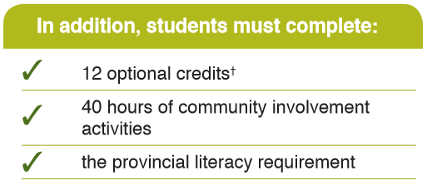
Credits to
Graduate:
Notes:
https://www.granderie.ca/board/secondary/graduate/graduation-requirements
18 compulsory credits and 12 optional credits

Slide 7
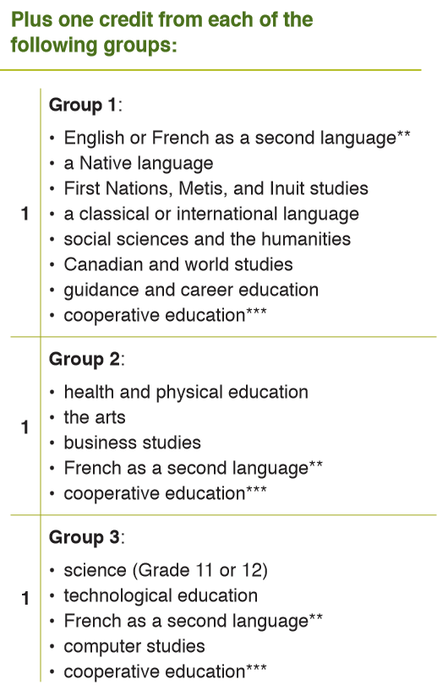
Notes:
Explain Group 1, 2 &3

Slide 8
Grade 9 and 10 Pathways:
Types of courses available:
Academic courses (D)
Non-Credit courses (K)
Locally developed courses (L)
Open courses (O)
Applied courses (P)
Destreamed Math
Notes:
In Grade 9 & 10 students may take courses in the academic, locally-developed, open, and applied pathways. In self-contained special education classes, students may take courses that do not lead to credits.
Students may choose courses from different pathways. Example: They could take Academic English and Applied Geography.
Starting in the 2021-22 school year, math will be offered as a destreamed class.

Slide 9
Academic Courses(D) - Often leads to post-secondary education, including College, University, and Apprenticeship; or to Workplace
These Courses:
• Focus on the essential concepts of a subject and explore related concepts
• Develop students’ knowledge and skills through the study of theory and abstract problems
• Incorporate practical applications as appropriate
• Present and evaluate curriculum at a measured/brisk pace according to students’ needs
Notes:
STUDENTS MAY PRESENT WITH:
Effective work habits and learning skills combined with developing academic readiness
Effective academic readiness combined with developing work habits and learning skills

Slide 10
Non-Credit Courses (K) - May lead to a Certificate of Accomplishment, support work/living, and in some cases, an Ontario Secondary School Certificate
Special Education Courses (K) - allow students to focus on functional life skills and/or job readiness skills within schools that have a self-contained special education setting. Expectations are individualized for students who have a variety of strengths and needs. In some cases, these courses can be preparation for participation in Locally Developed Compulsory Courses.

Slide 11
Locally Developed Courses (L)– courses may be chosen based on conversations with the Family, Learning Resource Teacher, and Classroom Teacher
THESE COURSES are designed for students who have specific-learning needs and require more direction in the classroom. Students will learn essential and practical concepts of a subject.
Notes:
STUDENTS MAY PRESENT WITH:
Emerging work habits and learning skills combined with developing academic readiness
Emerging academic readiness combined with developing work habits and learning skills

Slide 12
Open Courses (O) - allow students to learn concepts and skills designed to prepare them for further study in the subject area. Generally the optional courses (art, business studies, drama, family studies, music, physical education and technology courses) are offered at the open level.
Expectations are created for all students and these students can have a variety of learning skills.

Slide 13
Applied Courses (P) - May lead to post-secondary education, including College or Apprenticeship; or to Workplace
THESE COURSES:
• Focus on the essential concepts of a subject
• Develop students’ knowledge and skills through practical applications and concrete examples
• Use familiar situations to illustrate ideas
• Present and evaluate curriculum at a gradual pace according to students' needs
Notes:
STUDENTS MAY PRESENT WITH:
Effective work habits and learning skills combined with developing academic readiness
Effective academic readiness combined with developing work habits and learning skills

Slide 14
Destreamed Grade 9 Mathematics Course

Slide 15
Summer School Reach Ahead Opportunities
Reach ahead opportunities are available to Grade 7 and Grade 8 students who wish to acquire a secondary school credit prior to their official enrolment in secondary school. Summer school registration information will be available at granderie.ca.
Notes:
Applications for Summer School are available on the Grand Erie website at granderie.ca and normally available in May
Applications should be taken/sent to your elementary school.

Slide 16
Grade 11 and 12 Pathways:
Six types of courses are available:
College courses (C)
Workplace courses (E)
Non-Credit courses (K)
College/University courses (M)
Open courses (O)
University courses (U)
Notes:
Grade 11 & 12 students may choose courses from six different pathways.

Slide 17
Specialized Courses available in Grade 11 & 12:
Dual Credits/SWAC
Magnet Programs (horticulture, baking, auto body, small engines, cosmetology)
Co-operative Education
Advanced Placement (AP)
eLearning Courses
Notes:
Dual Credits provide a unique opportunity for students to gain a college AND secondary school credit at the same time
School Within A College SWAC is a Dual Credit program providing senior secondary students the opportunity to try out post-secondary education at a college campus while completing a high school diploma.
Magnet courses are unique two credit, half day programs offered in a semester format
These programs are offered at the grade 10, 11 and 12 level to all Brantford and Brant County second­ary schools
Magnet courses are offered in: auto body, green industries (hor­ticulture), baking, cooking & event planning, cosmetology, carpentry, masonry, small engines, health care and outdoor education
Co-operative education provides an opportunity for students to gain secondary school credits and work experience at the same time
Advanced Placement allows students to pursue university level studies while still attending secondary school.
eLearning courses are available at the Grade 11 & 12 level.

Slide 18

Specialist High Skills Major students complete a bundle of classroom courses, workplace experiences and sector certifications to receive a special designation, also known as the red seal, on their Ontario Secondary School Diploma.

Slide 19
Grand Erie secondary schools offer 35 SHSM Programs in 10 different economic sectors.
Arts and Culture Construction
Environment Health and Wellness
Horticulture Hospitality
Information Technology Manufacturing Sports Transportation

Slide 20
Ontario Youth Apprenticeship Program
Students gain knowledge and
experience in an apprenticeable
trade while working at an eligible work placement.
Apprenticeships are an excellent way of learning valuable work skills and are a viable alternative to traditional
post-secondary programs.
Notes:
Knowledge and experience in an apprenticeable trade while working at an eligible work placement
Students acquire hours toward the completion of their apprenticeship while earning credits
An apprenticeship is an agreement between the student (who wants to learn a skilled trade), the school, the employer (who teaches the skills), and the Ministry of Training, Colleges and Universities (MTCU) (Apprenticeship Branch)
TO BEGIN AN APPRENTICESHIP DURING HIGH SCHOOL A STUDENT MUST:
successfully complete 16 credits and be enrolled full-time in school
be 16 years of age or older
complete their Ontario Secondary School Literacy Requirement and all compulsory credits required for an Ontario Secondary School Diploma

Slide 21
Extra-curricular Opportunities at Secondary School:
Athletics (various sports per season and intramurals)
Clubs (Band, Drama, Chess, Yearbook, GSA)
Indigenous Students’ Council
Students’ Council
Student Advocacy Club
Spirit Clubs

Slide 22
Transition Activities for CSS
-CSS Guidance staff distribute option booklets to grade 8
classrooms
-transition tour video included in this slide show (next slide)
-transition videos for each department will be available to
grade 8 teachers to watch with the students as a class
-grade 8 parent evening through Microsoft Teams which is being held on Thursday, December 3/2020. Invitation link to join the virtual meeting was sent by email from the grade 8 teacher.

Slide 23
Please be patient and allow the video to load before the play button appears.
https://youtu.be/YJhWRiY5dtM

Slide 24
Transition to Secondary School
CSS Virtual Grade 8 Parent Night is on Thursday, Dec.3/2020 at 6:30pm
To join the meeting on Dec 3, please see the next slide.
To open, go to the next slide, hit ctrl and click on the link.
Notes:
Schools to personalize with their information

Slide 25
https://teams.microsoft.com/l/meetup-join/19%3ameeting_NGRiYjI2OWItZWM1YS00MmRhLWJiNGEtNzRkNTRhY2Q0MzYx%40thread.v2/0?context=%7b%22Tid%22%3a%22f4e5b749-8fd9-48fe-b056-79815a973799%22%2c%22Oid%22%3a%22d74340cb-07e9-4c33-8a7b-84bfa586dc2b%22%7d

